Slide 1
HERO AD UNIT
Updated as of 10/03/17
1

Slide 2
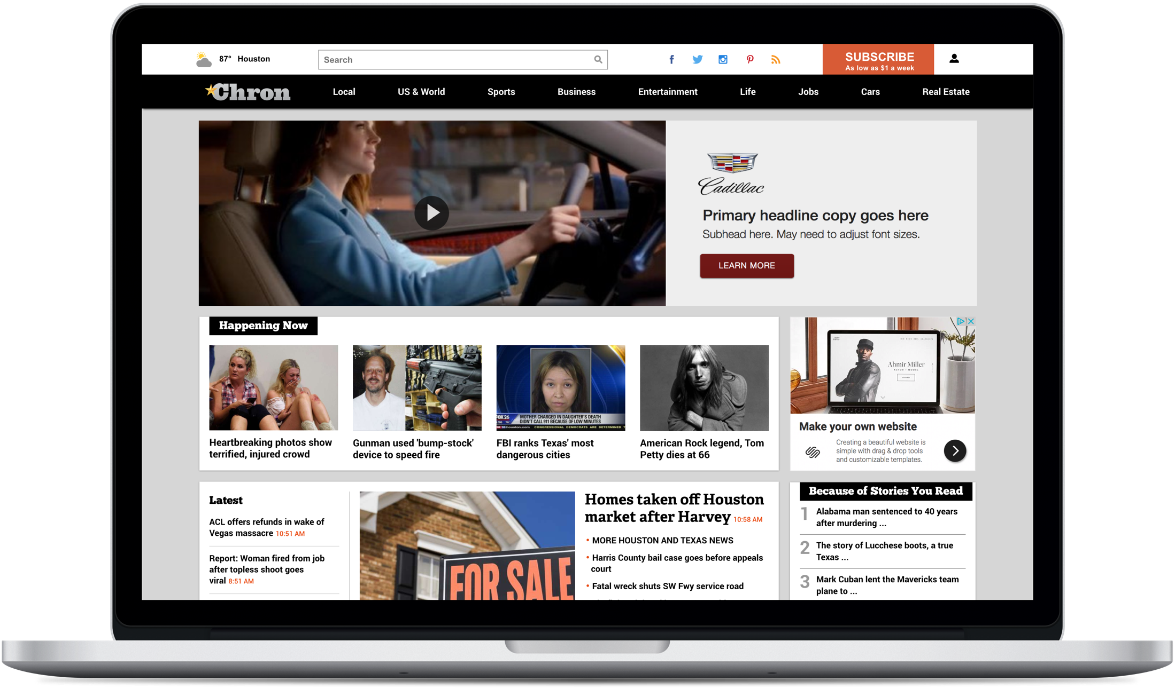
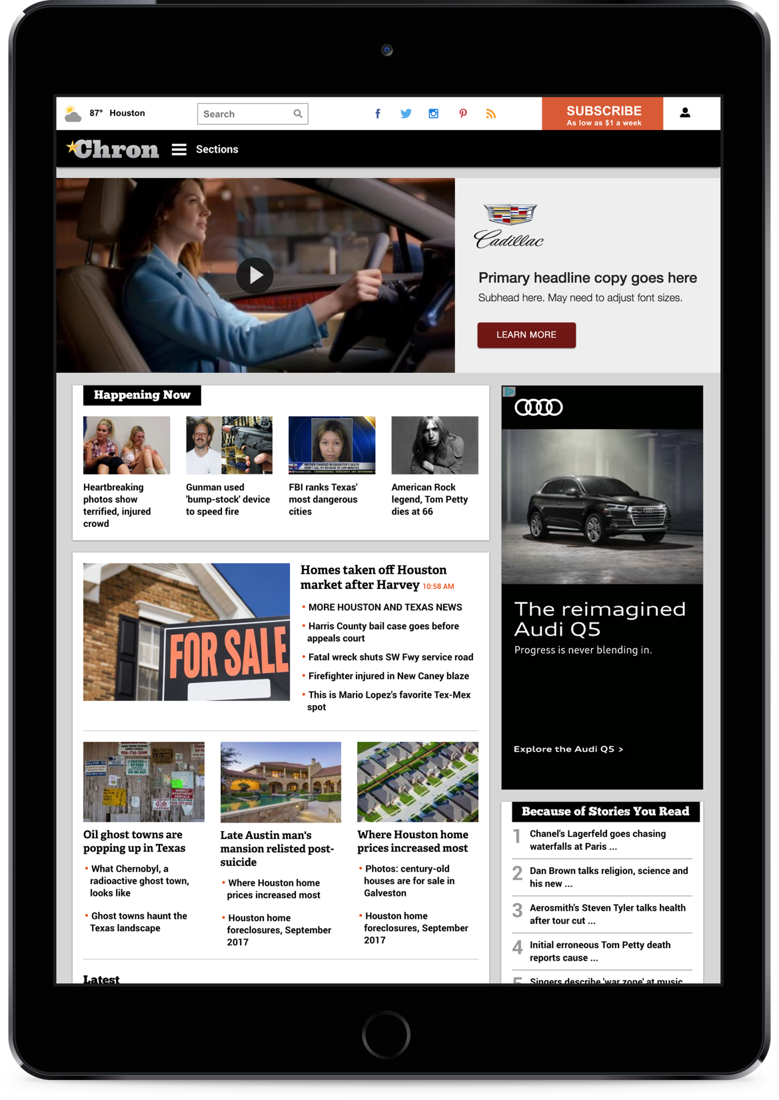
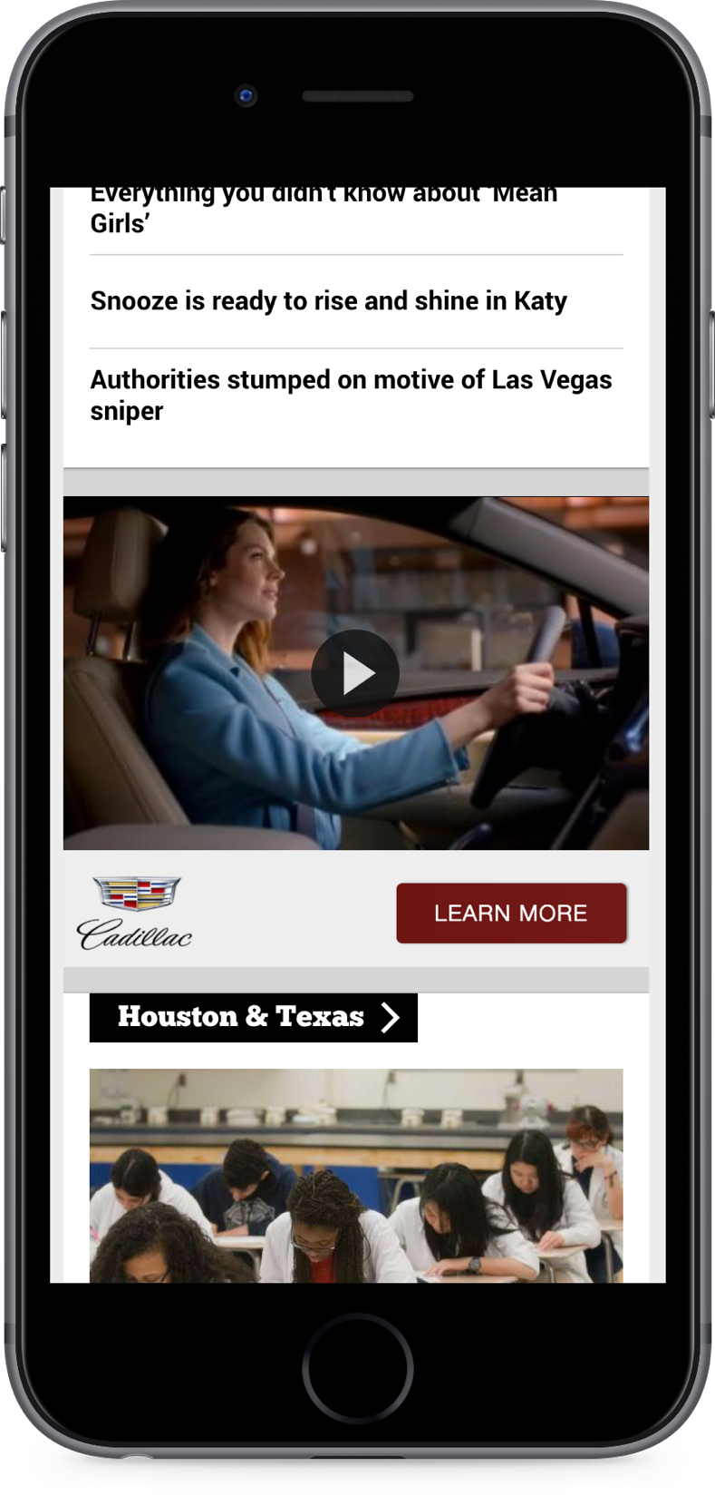
HERO OVERVIEW
Hero is a highly visible and versatile ad format, designed to communicate your brand’s message in a manner that compliments the reading experience.
High impact and fully responsive, Hearst’s Hero unit is an elegant and effective tool for reaching audiences across platforms.
2

Slide 3
HERO COMPONENTS
The hero is comprised of two panels: a left and a right. Each panel contains a specified set of components which, when placed within the hero framework, will dynamically adapt to any screen size.
60% Width
40% Width
IMAGERY PANEL
You brand’s best video, photo, or series of photos. Your choice.
MESSAGING PANEL
Your Brand’s logo, a brief brand message, and a call to action.
3

Slide 4
HERO FORMATS
The hero comes in a variety of image-rich formats, allowing you to choose the most engaging way to showcase your brand’s creative.
VIDEO
SLIDESHOW
SINGLE IMAGE
4

Slide 5
HERO SPECS
SPECS FOR VIDEO HERO UNITS
GENERAL SPECS
Size
Platforms
Placement
Reporting
100% screen width, 300px height (all platforms)
Desktop, Tablet, Mobile Web
Home Page, Section Fronts, Article Pages (no video or slideshow pages) for a 24 hour period (Note: Frequency cap of 1 per user per hour for Article Pages only)
Impressions, Clicks and CTR, Engagement Rate, Average Time Spent, Video Completion Rate
CREATIVE ASSETS REQUIRED
Logo
Copy
CTA
Video
Vector file (ai, eps, svg), or transparent PNG
Headline (20 char max) + Subhead (30 char max)
With clickthrough URL
.mp4 format
30 seconds max duration
10mb max size
No lower thirds or other graphics close to edge of frame
5

Slide 6
HERO SPECS
SPECS FOR SLIDESHOW HERO UNITS
GENERAL SPECS
Size
Platforms
Placement
Reporting
100% screen width, 300px height (all platforms)
Desktop, Tablet, Mobile Web
Home Page, Section Fronts, Article Pages (no video or slideshow pages) for a 24 hour period (Note: Frequency cap of 1 per user per hour for Article Pages only)
Impressions, Clicks and CTR, Engagement Rate, Average Time Spent, Video Completion Rate
CREATIVE ASSETS REQUIRED
Logo
Copy
CTA
Images
Vector file (ai, eps, svg), or transparent PNG
Headline (20 char max) + Subhead (30 char max)
With clickthrough URL
3-5 images total
jpg or png
800px min width
Only centrally located text and graphics
6

Slide 7
HERO SPECS
SPECS FOR SINGLE IMAGE HERO UNITS
GENERAL SPECS
Size
Platforms
Placement
Reporting
100% screen width, 300px height (all platforms)
Desktop, Tablet, Mobile Web
Home Page, Section Fronts, Article Pages (no video or slideshow pages) for a 24 hour period (Note: Frequency cap of 1 per user per hour for Article Pages only)
Impressions, Clicks and CTR, Engagement Rate, Average Time Spent, Video Completion Rate
CREATIVE ASSETS REQUIRED
Logo
Copy
CTA
Image
Vector file (ai, eps, svg), or transparent PNG
Headline (20 char max) + Subhead (30 char max)
With clickthrough URL
jpg or png
800px min width
Only centrally located text and graphics
7

