Slide 1
O&O Ad Product Portfolio Designer/Ad Ops Training Resource
Updated 11.10.2020

Slide 2
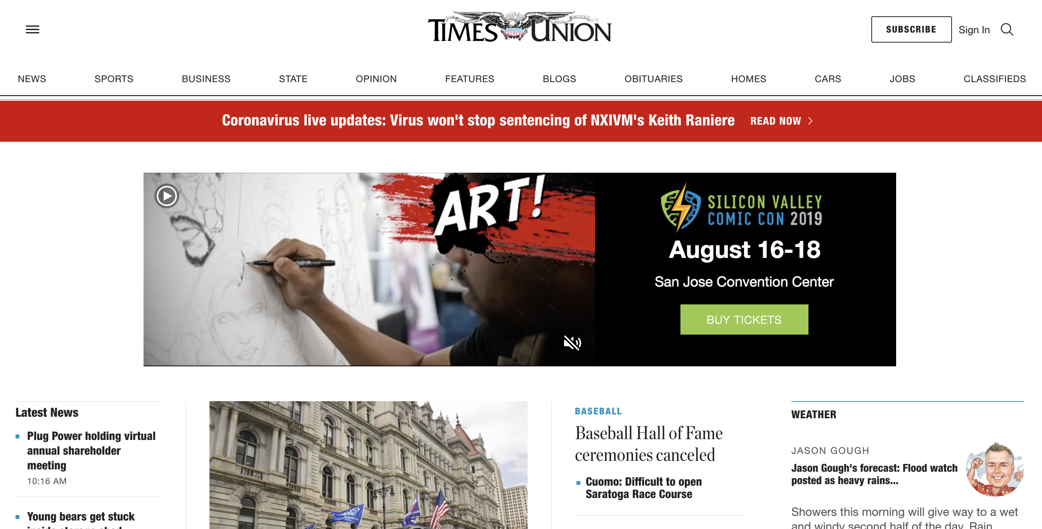
Billboard with Video (Desktop and Tablet landscape)
Billboard with Video
Fixed 970x250 size
Desktop and Tablet (landscape view)
PAGE | 🖥 | 🀫 | 📱
Classic Channel | ✓ | L
Classic Article | ✓ | L
Shared Channel | ✓ | L
Shared Article | ✓ | L
Link to live demo: www.timesunion.com?demo=BillboardWithVideo
INTERNAL USE ONLY
landscape
Notes:
Specs/Assets required:
- Video file
Logo
Headline: 20 characters Max
Subhead: 30 characters Max
Video: 16:9 no text within video creative

Slide 3
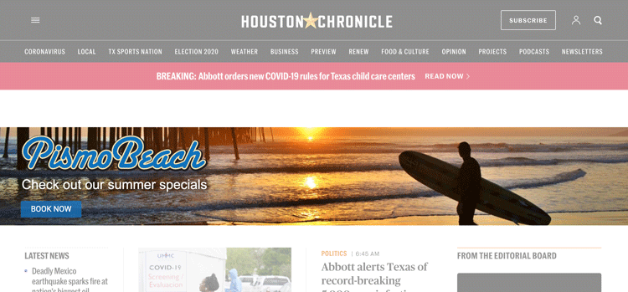
Supreme (Full Image)
Responsive to all screen sizes and devices
Full image background
Site Support:
Redesigned homepage and section front support
Soon to be available on Shared Article Templates
PAGE | 🖥 | 🀫 | 📱
Classic Channel
Classic Article
Shared Channel | ✓ | ✓ | ✓
Shared Article | ✓ | ✓ | ✓
Link to live demo: www.houstonchronicle.com?demo=Supreme
INTERNAL USE ONLY

Slide 4
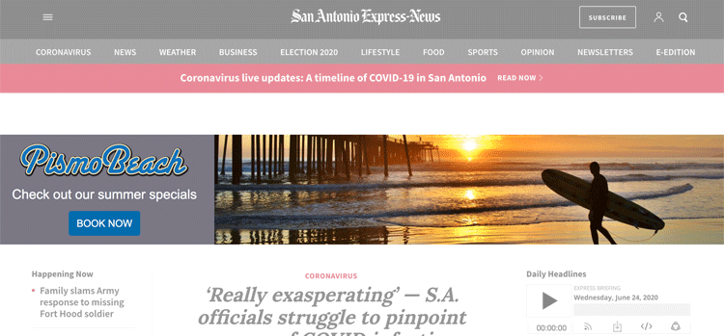
Supreme (Image Right)
Responsive to all screen sizes and devices
2-panel format with static image
Site Support:
Redesigned homepage and section front support
Soon to be available on Shared Article Templates
PAGE | 🖥 | 🀫 | 📱
Classic Channel
Classic Article
Shared Channel | ✓ | ✓ | ✓
Shared Article | ✓ | ✓ | ✓
Link to live demo: https://www.expressnews.com/?demo=Supreme
INTERNAL USE ONLY

Slide 5
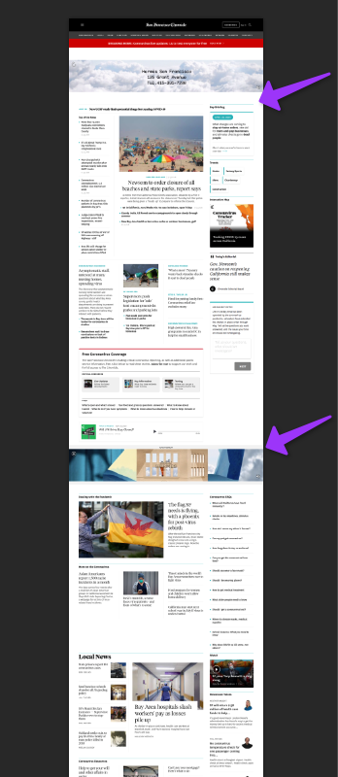
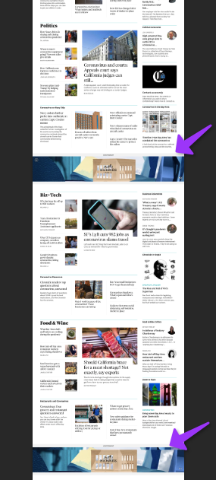
Supreme Takeover Tell your brand’s story on our trusted Homepage

Slide 6
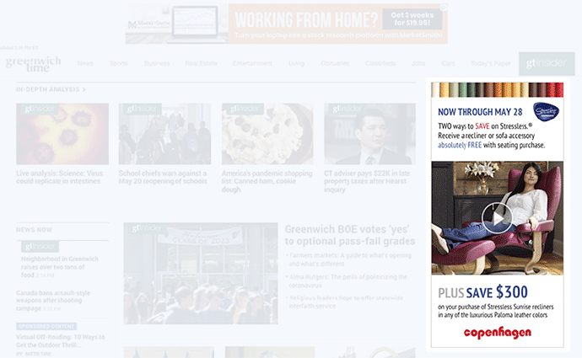
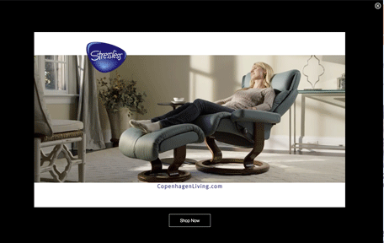
Turn your creative into a full screen experience
Cinema
User-initiated click to expand creative
Full-screen video experience
Close creative
PAGE | 🖥 | 🀫 | 📱
Classic Channel | ✓ | L
Classic Article | ✓ | L
Shared Channel | ✓ | L
Shared Article | ✓ | L
Link to live Cinema on Greenwich Time: www.greenwichtime.com?demo=CopenhagenCinema
INTERNAL USE ONLY
landscape

Slide 7
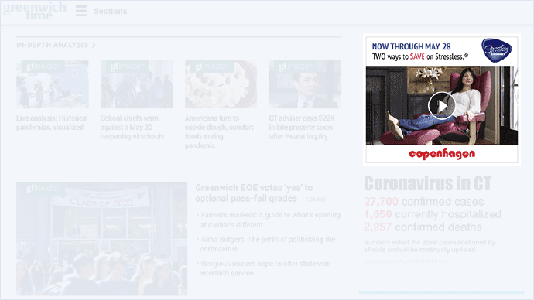
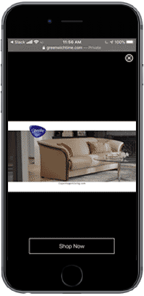
Mini Cinema
Cross-platform support
Scalable
Impactful
Mini Cinema (300x250) on all devices
Click to expand video full-screen!
Site Support
All
PAGE | 🖥 | 🀫 | 📱
Classic Channel | ✓ | ✓ | ✓
Classic Article | ✓ | ✓ | ✓
Shared Channel | ✓ | ✓ | ✓
Shared Article | ✓ | ✓ | ✓
Link to live demo: www.greenwichtime.com?demo=CopenhagenMiniCinema
INTERNAL USE ONLY

Slide 8
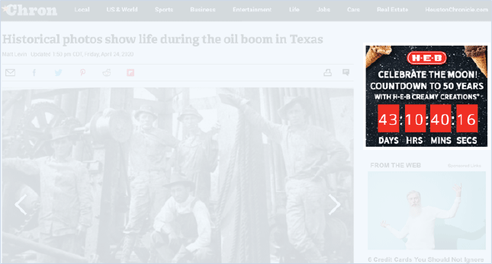
Countdown Clock
Increase event awareness across all platforms
Use Cases:
Grand opening
Holiday sale
Sporting event
Local event
PAGE | 🖥 | 🀫 | 📱
Classic Channel | ✓ | ✓ | ✓
Classic Article | ✓ | ✓ | ✓
Shared Channel | ✓ | ✓ | ✓
Shared Article | ✓ | ✓ | ✓
Link to live HEB Demo: https://www.chron.com/life/article/Historic-photos-show-life-during-the-oil-boom-in-6665505.php?demo=CountdownClock

Slide 9
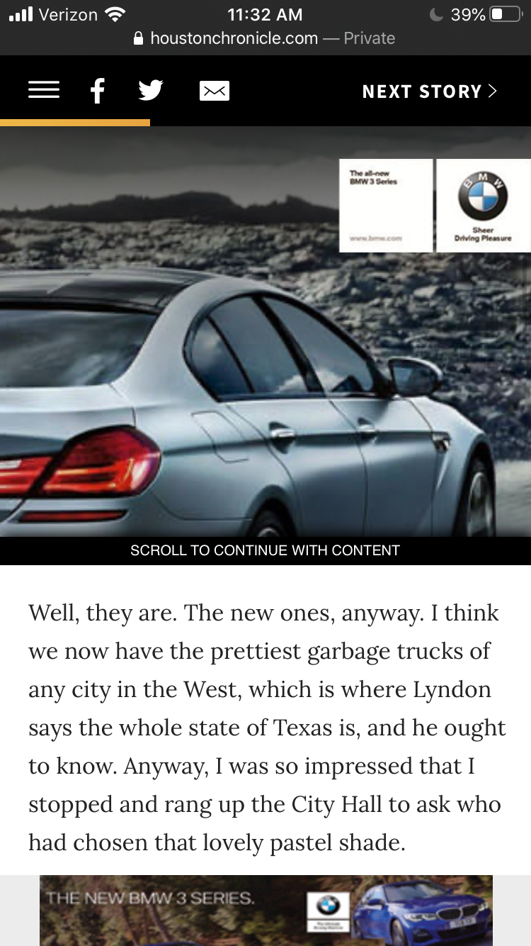
Interscroller (Mobile)
Seamless in-line article placement
User-friendly and fun!
Non-interruptive to natural scrolling behavior
Elegant and native-feel
Sponsorship Opportunities
First ad inline and mobile adhesion unit
PAGE | 🖥 | 🀫 | 📱
Classic Channel
Classic Article |  |  | ✓
Shared Channel
Shared Article |  |  | ✓
Click-through capability
Link to live demo (Mobile Only): www.houstonchronicle.com/local/bayou-city-history/article/Sigman-Byrd-Lavenders-blue-green-on-the-road-to-15210803.php?demo=Interscroller_Image

Slide 10
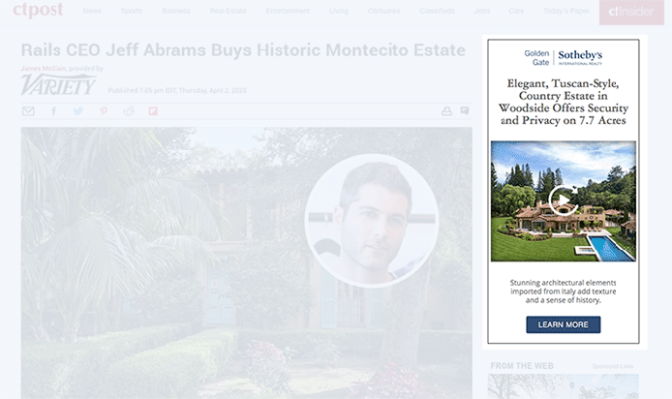
Showcase multiple products in one ad unit!
Flipbook
Brand Awareness
Highlights
Automatic rotation of slides and replay feature
Feature 4-7 images
Promote multiple products
Use Cases
Real estate listings
Rooms in a house
Cars
PAGE | 🖥 | 🀫 | 📱
Classic Channel | ✓ | ✓ | ✓
Classic Article | ✓ | ✓ | ✓
Shared Channel | ✓ | ✓ | ✓
Shared Article | ✓ | ✓ | ✓
Link to Demo page: http://www.ctpost.com/entertainment/article/Rails-CEO-Jeff-Abrams-Buys-Historic-Montecito-15174595.php?demo=FlipbookCrossDevice
Notes:
Specs/Assets Required
4-7 high-res wide images

Slide 11
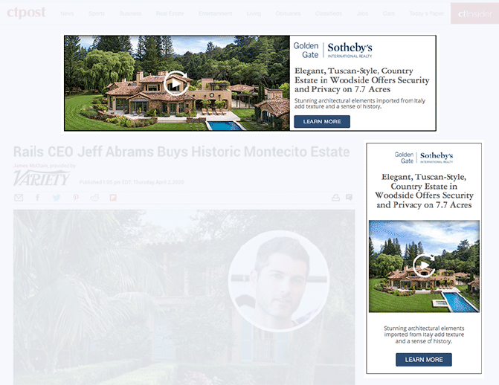
Flipbook
970x250 also available!
Sponsorship opportunities
First two ads below the navigation bar
970x250 + 300x250
PAGE | 🖥 | 🀫 | 📱
Classic Channel | ✓ | L
Classic Article | ✓ | L
Shared Channel | ✓ | L
Shared Article | ✓ | L
Link to Demo page: www.ctpost.com/entertainment/article/Sunflowers-CT-farms-spreading-a-little-floral-15415521.php?demo=FlipbookCrossDevice
landscape

Slide 12
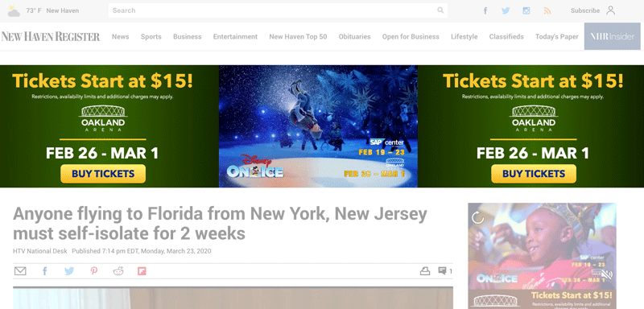
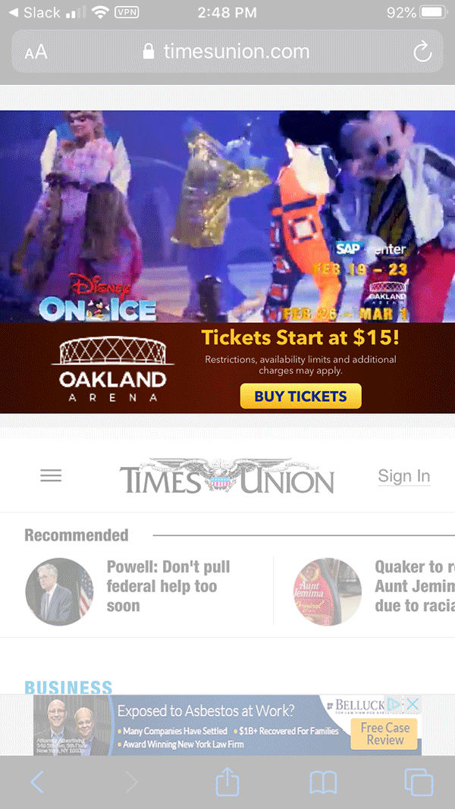
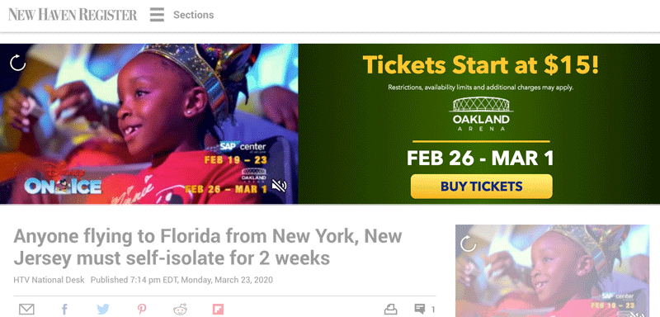
Superhero
Highlights:
Fully Responsive with a unique layout for every major breakpoint!
Full width span
Available to all devices
250 px max height
Before: 300 px height with frequency cap and page type limitations. With move to Shared Template and shorter height, Superhero has more opportunities.
PAGE | 🖥 | 🀫 | 📱
Classic Channel | ✓ | L
Classic Article | ✓ | L
Shared Channel | ✓ | ✓ | ✓
Shared Article | ✓ | ✓ | ✓
Link to demo page on classic article:
https://www.nhregister.com/news/article/Governor-says-anyone-traveling-to-Florida-from-15152148.php?demo=SuperheroVideoEmbed
Link to demo page on shared article:
https://www.timesunion.com/business/article/Masks-become-standard-fare-for-air-travel-15245712.php?demo=SuperheroVideoEmbed
INTERNAL USE ONLY

Slide 13
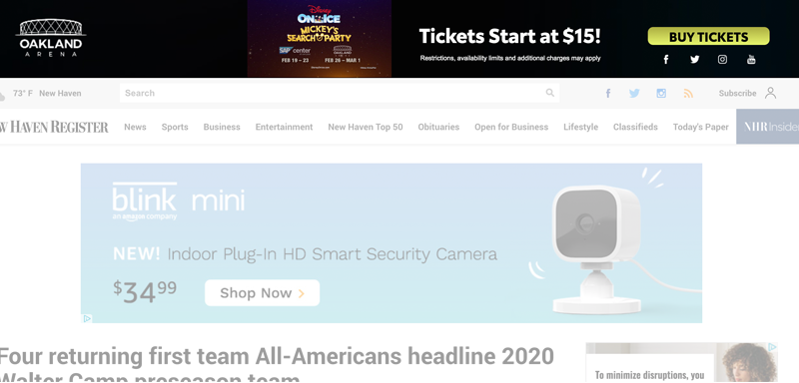
Premier
Highlights:
First placement on the site
100% width
Video capabilities
Ability to promote social channels
Highlights:
First placement on the site
100% width
Video capabilities
Ability to promote social channels
PAGE | 🖥 | 🀫 | 📱
Classic Channel | ✓ | ✓
Classic Article | ✓ | ✓
Shared Channel
Shared Article
Link to demo: https://www.nhregister.com/sports/article/Four-returning-first-team-All-Americans-headline-15333995.php?demo=Premier

Slide 14
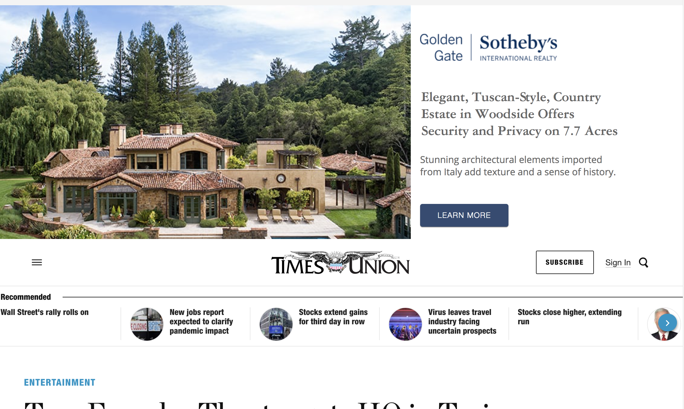
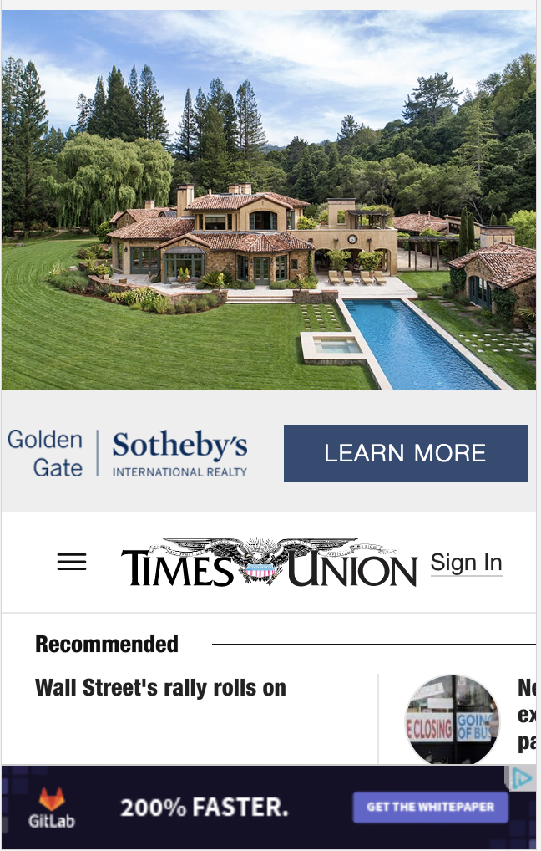
Crown (Wallpaper replacement)
Highlights:
High-impact top of the page spread
400 px max height on Desktop
300 px max height on Mobile
New: Supported on all devices!
Static only
PAGE | 🖥 | 🀫 | 📱
Classic Channel
Classic Article
Shared Channel | ✓ | ✓ | ✓
Shared Article | ✓ | ✓ | ✓

Slide 15
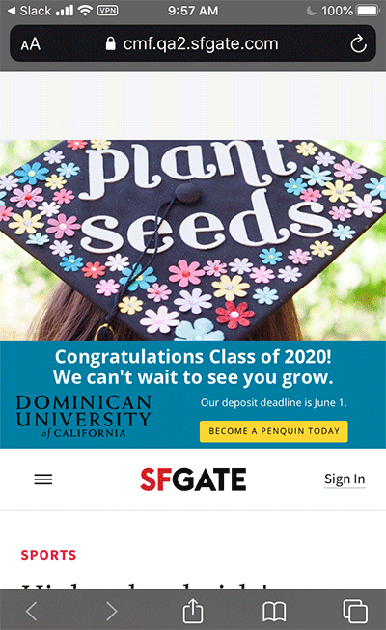
Super Crown
Highlights:
Highest impact top of the page spread
600 px max height on desktop
300 px max height on mobile
New: Supported on all devices!
Min spend recommended
Static only
PAGE | 🖥 | 🀫 | 📱
Classic Channel
Classic Article
Shared Channel | ✓ | ✓ | ✓
Shared Article | ✓ | ✓ | ✓

Slide 16
Rich Media Specs and Naming Conventions
https://bit.ly/HNP_RichMedia_Specs_FINAL
http://bit.ly/Celtra_CreativeNameGuide

Slide 17
Building: Best Practice and Guidelines
Within Celtra, please adhere to following page weight guidelines (updated November 2020):
You may have noticed a change in how page weight variants are displayed within Celtra. The new table is much easier to read and will show the “Estimated Initial Weight” AND “Estimated Full Weight”. Prior to Google Chrome Heavy Ad Intervention , Celtra had recommended <350 KB on Desktop and <200 KB on Mobile.
The NEW guidelines for page variants to be followed immediately is: Estimated Initial Weight should be < 4MB for all devices.
If creative do not meet the following criteria, the ad will be blocked or unloaded from the site if the reader is using a Chrome.
· Uses the main CPU thread for more than 60 sec in total
· Uses the main CPU thread for more than 15 sec in any 30-sec window
· Uses more than 4 MB of network bandwidth
Here is additional information on building recommendations for handing Chrome Ad Blocking: https://support.celtra.com/creative/builder/recommendations-for-chrome-heavy-ad-interventions

Slide 18
IAB and Better Ads Standards
IAB New Standard Ad Unit Portolio
IAB Fixed Sized Ad Specifications
https://www.betterads.org/standards/
Chrome Heavy Ad Intervention: https://www.chromestatus.com/feature/4800491902992384

Slide 19
Pricing Framework
Richer ads = richer experience and production
Tier 1: Basic
Static Billboard
Tier 2: Rich Media Fixed
Billboard (Fixed Hero) with video
Cinema
Interscroller (mobile article only)
Flipbook
Tier 3: Rich Media Plus (Responsive)
Superhero
Supreme
Crown
Framework
Basic and Rich Media Fixed: $20 CPM
Rich Media+: $22-25 CPM
Crown and Super Crown business rule: Only one rich media per page. Can be sold with 300x250 companion – SUPER CROWN MUST HAVE A CROWN TO DEFAULT TO AFTER INITIAL OPEN
Up to 10-15% discount given frequency/volume of campaign
Additional geo/audience targeting may increase base rich media price

Slide 20
Local Production Process
Connect with your Ad Ops teams.
2-3 week turnaround time for high impact units from when assets are received. If advertiser is able to provide assets that are within our specs, turnaround time could be 1-2 weeks.
High Impact units are built 3-4x in the platform (one ad variant for each breakpoint)
Notes:
supreme, superhero, crown. caveat superhero and crown will not be ready until mid/end of july

